Slide 1




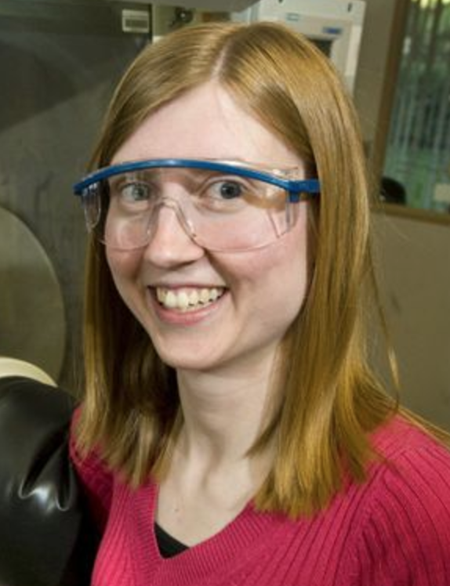

Redox Switchable Polymerization by Yttrium and Indium Complexes
Sooihk Ro, Alexander Laughlin, Paula L. Diaconescu
University of California, Los Angeles, CA, USA
Introduction
Redox Switchable Catalyst
Characterization of Metal Complexes
The ring-opening polymerization (ROP) of cyclic esters is a resourceful method for the production of polyesters. As such, there is interest in obtaining a high degree of control over the polymerization process. Selective control can be obtained through redox-switchable catalysts, which selectively induce and inhibit the ring-opening polymerization of certain monomers.
NMR spectroscopy was utilized to analyze the purity and yield of products. HSQC, CV, and XRAY crystallography will be utilized to further characterize the metal complexes. GPC will be used for the analyzing the polymers.
2: M = Y, R₁ = tBu, R₂ = O^{t}Bu
4: M = In, R₁ = tBu, R₂ = OPh
Having a ferrocene backbone allows 2-Y(O^{t}Bu) and 4-In(OPh) to be switched between their oxidized and reduced states. Previous research showed 1-Y(O^{t}Bu) was able to polymerize L-lactide in its reduced state but not in its oxidized state. Opposite behavior was observed for the polymerization of trimethylene carbonate with 3-In(OPh). We are investigating the change in reactivity for each metal complex as we switch the substituents (R = O^{t}Bu, OMe, OCF₃) on the supporting ligand. Cyclic voltammetry will be utilized to test the redox reversibility of 2-Y(O^{t}Bu) and 4-In(OPh).
Synthesis of Ligands
1: M = Y, R₁ = H, R₂ = O^{t}Bu
2: M = Y, R₁ = tBu, R₂ = O^{t}Bu
3: M = In, R₁ = H, R₂ = OPh
4: M = In, R₁ = tBu, R₂ = OPh
It was reported that an yttrium alkoxide phosfen complex (1-Y(O^{t}Bu), phosfen = 1,1’-di(2-tert-butyl-6-diphenylphosphiniminophenoxy)ferrocene) could be used to control the polymerization of L-lactide through redox processes. In addition. an indium phosfen aryloxide (3-In(OPh) supported by the same ligand was reported to control the polymerization of trimethylene carbonate through redox processes. We substituted the R group in the para position of the phenol ring in the ligand with a tert-butyl group in order to synthesize 2-Y(O^{t}Bu) and 4-In(OPh).
Synthesis of Yttrium and Indium Complexes
Acknowledgments
1: M = Y, R₁ = H, R₂ = O^{t}Bu, X = K
2: M = Y, R₁ = tBu, R₂ = O^{t}Bu, X = K
3: M = In, R₁ = H, R₂ = OPh, X = Na
4: M = In, R₁ = tBu, R₂ = OPh, X = Na

